Slide 1

Pandit Deendayal Energy University
3rd Sem Summer Internship Project Evaluation
Prepared by :
Dev Jethva
(23MDS003)
Under the guidance of
Dr. Yogesh Kumar
Topic
White Blood Cell Image Classifier using Deep learning Techniques

Slide 2
Table of Contents
Abstract
Introduction
Problem Statement
Literature review
Dataset
Proposed Model Architecture
Result & Code
Conclusion & Future Direction
References

Slide 3
Abstract
Accurate and early detection of anomalies in peripheral white blood cells plays a crucial role in the evaluation of well-being in individuals and the diagnosis and prognosis of hematologic diseases. For example, some blood disorders and immune system-related diseases are diagnosed by the differential count of white blood cells, which is one of the common laboratory tests. Data is one of the most important ingredients in the development and testing of many commercial and successful automatic or semi-automatic systems. To this end, this study introduces a free access dataset of normal peripheral white blood cells called WBC containing about 40,000 images of white blood cells and color spots.

Slide 4
Introduction
White blood cells, also known as leukocytes, are the frontline soldiers of the immune system. These cells circulate in the blood and lymphatic system, constantly patrolling for invaders like bacteria, viruses, and parasites. They help protect us from infections and foreign invaders. White blood cells can be classified two main categories: granulocytes and agranulocytes.

Slide 5
Problem Statement
Detection and identification of white blood cell disease using various deep learning algorithm.

Slide 6
Literature Survey
References | Methodology | Algorithm | Accuracy | Dataset used
Machiraju Jaya Lakshmi et al. [1] | Brain tumor Classification using SoftMax classifier | Inception –V3 | 89.00% | 3064 MRI Images
Wen Jun & Zheng Liyuan [2] | Brain tumor Classification using attention mechanism | CNN | 98.61% | 3043 MRI Images
Arshia Rehman et.al. [3] | Three-layer architecture of CNN with transfer learning technique | VGG-16 and CNN | 98.69% | MRI brain slices of 233 Patients.
R. Rajasree et al. [4] | Brain tumor classification using deep learning | U-NET, CNN | 96.36% | BRAST 2015
Aman Verma et al. [5] | Brain tumor classification using deep model | CNN | 97.87% | MRI images

Slide 7
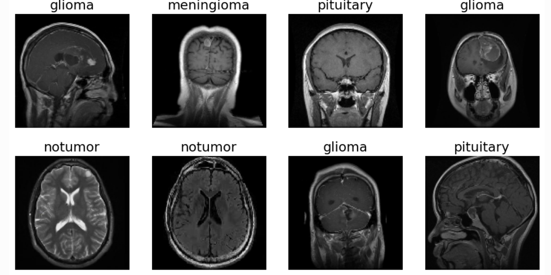
Dataset
This dataset contains 7023 images of human brain MRI images which are classified into 4 classes: Glioma, Meningioma, No tumor, and Pituitary. These folders have MRI images of the respective tumor classes. In this dataset, there are two types of folders: training and testing.

Slide 8
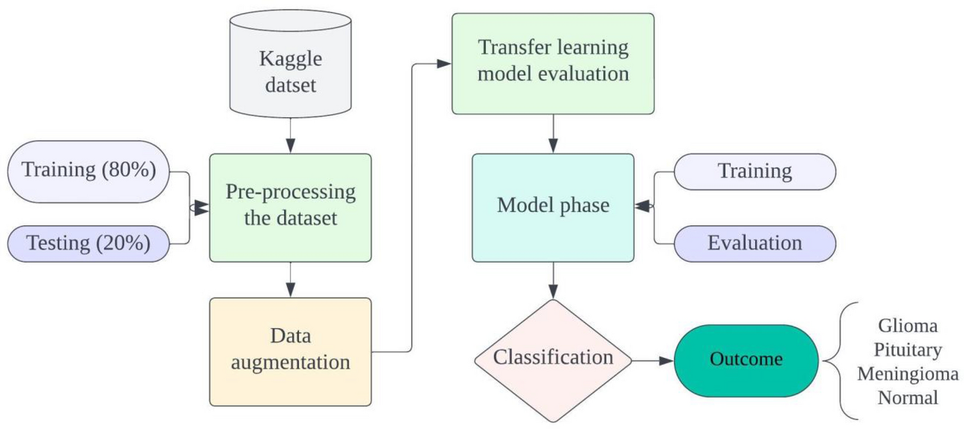
Proposed Model Architecture
I have use the method of VGG16 for Transfer Learning
Proposed Model Architecture:

Slide 9
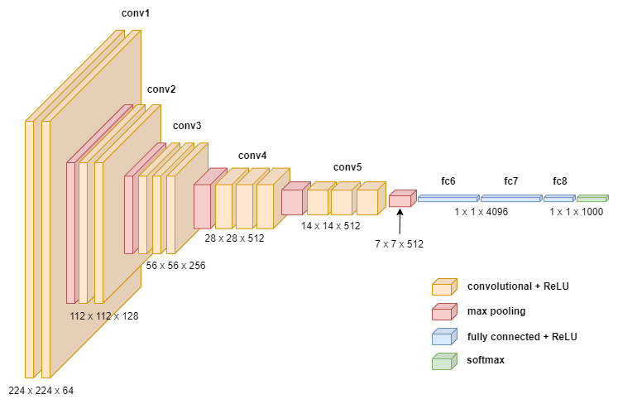
VGG16 Net Diagram:
credit: towardsdatascience

Slide 10
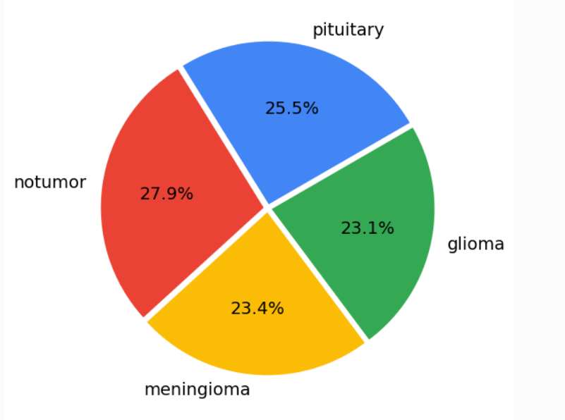
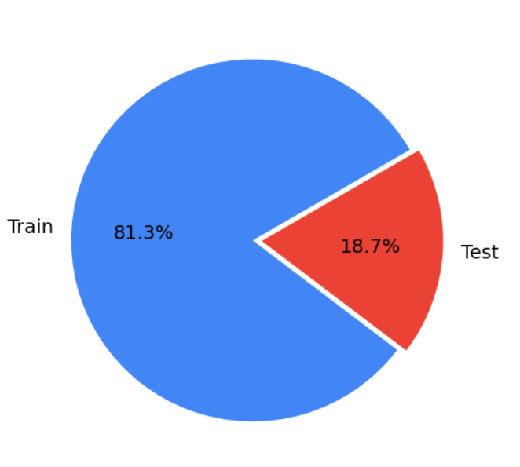
Results
Training and testing dataset for each class.
Each label percentage of Train and test data

Slide 11
Result
Data Augmentation:

Slide 12
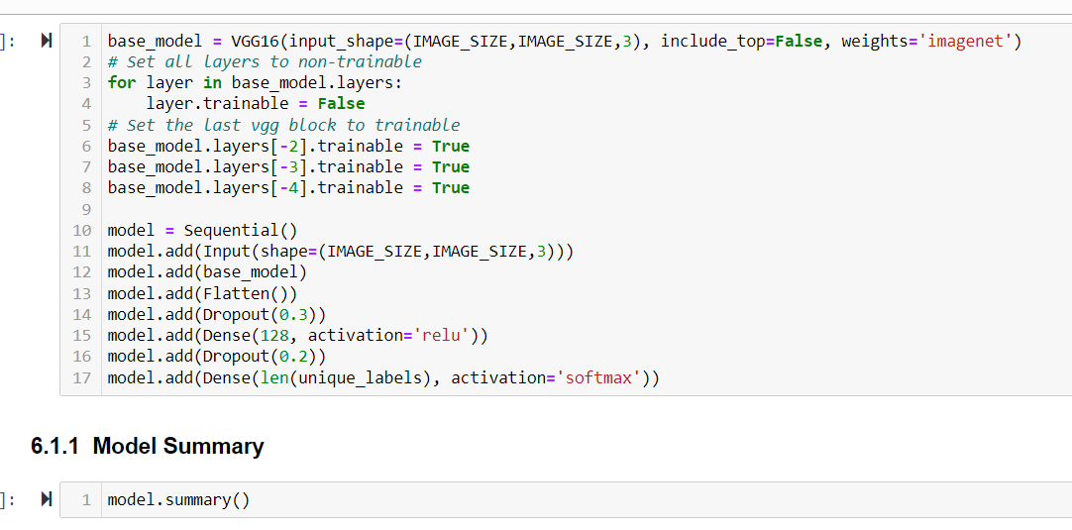
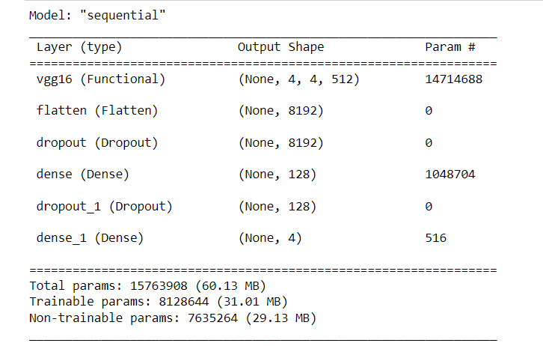
Code

Slide 13
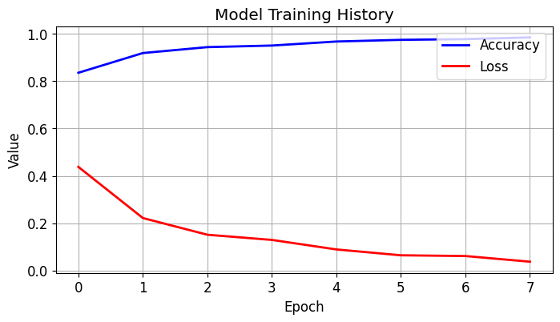
Results
Training History of the model with accuracy and loss of no.of epoch

Slide 14
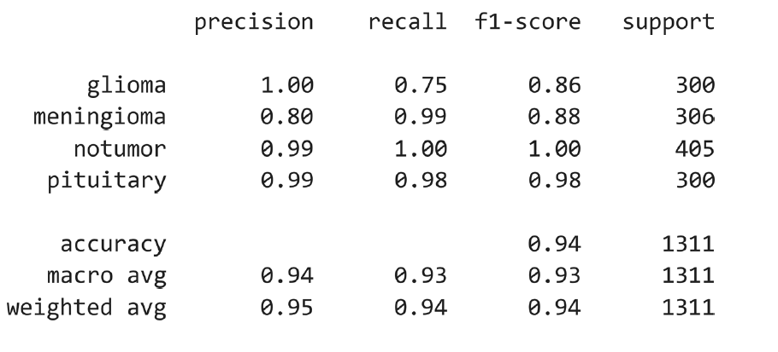
Result
Classification Report for the test dataset.

Slide 15
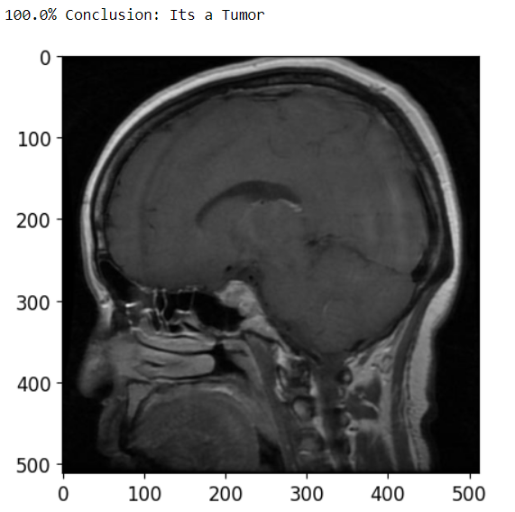
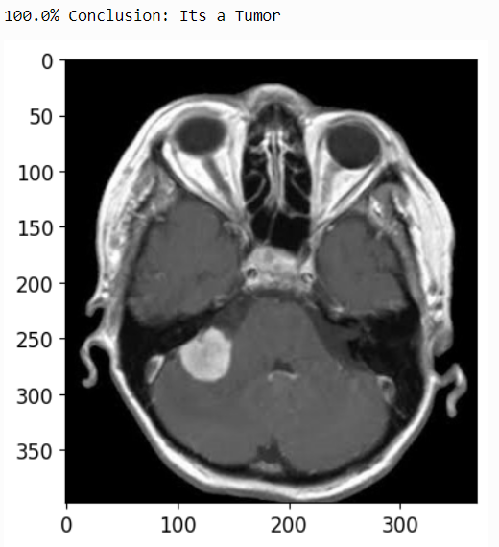
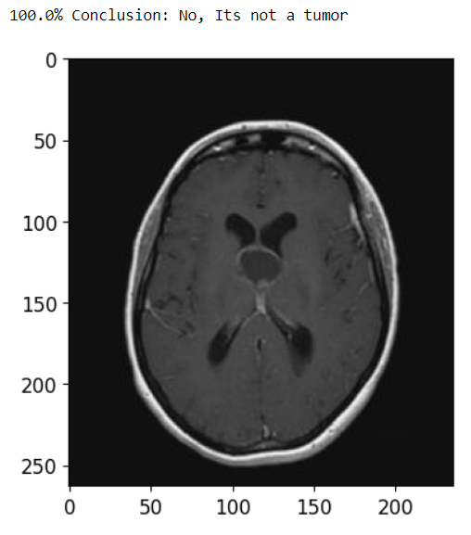
Result
Check the working of the model:
Pituitary Image
Meningioma Image
No Tumor Image

Slide 16
Conclusion &Future Direction
Model provides good accuracy of 94% and can distinguish between different types of tumor and non-tumor images.
This accomplishment underscores the effectiveness of leveraging pre-trained models for medical image analysis tasks.
I have done about VGG16 models now, my next task is to try another transfer learning method like VGG19, ResNet-50, DenseNet, etc.

Slide 17
References
[1] M. J. Lakshmi and S. N. Rao, ‘‘Brain tumor magnetic resonance image classification: A deep learning approach,’’ Soft Comput., vol. 26, no. 13, pp. 6245–6253, Jul. 2022, doi: 10.1007/s00500-022-07163-z.
[2] W. Jun and Z. Liyuan, ‘‘Brain tumor classification based on attention guided deep learning model,’’ Int. J. Comput. Intell. Syst., vol. 15, no. 1, p. 35, Dec. 2022, doi: 10.1007/s44196-022-00090-9.
[3] A. Rehman, S. Naz, M. I. Razzak, F. Akram, and M. Imran, ‘‘A deep learning-based framework for automatic brain tumors classification using transfer learning,’’ Circuits, Syst., Signal Process., vol. 39, no. 2, pp. 757–775, Feb. 2020, doi: 10.1007/s00034-019-01246-3.
[4] R. Rajasree, C. C. Columbus, and C. Shilaja, ‘‘Multiscale-based multimodal image classification of brain tumor using deep learning method,’’ Neural Comput. Appl.,

Slide 18
References
vol. 33, no. 11, pp. 5543–5553, Jun. 2021, doi: 10.1007/s00521-020-05332-5.
[5] A. Verma and V. P. Singh, ‘‘Design, analysis and implementation of efficient deep learning frameworks for brain tumor classification,’’ Multimedia Tools Appl., vol. 81, no. 26, pp. 37541–37567, Nov. 2022, doi: 10.1007/s11042-022-13545-0.
[6] https://www.nature.com/articles/s41598-024-57970-7
[7] https://www.mdpi.com/2076-3417/12/14/7282

Slide 19
Thank you

